Slide 1

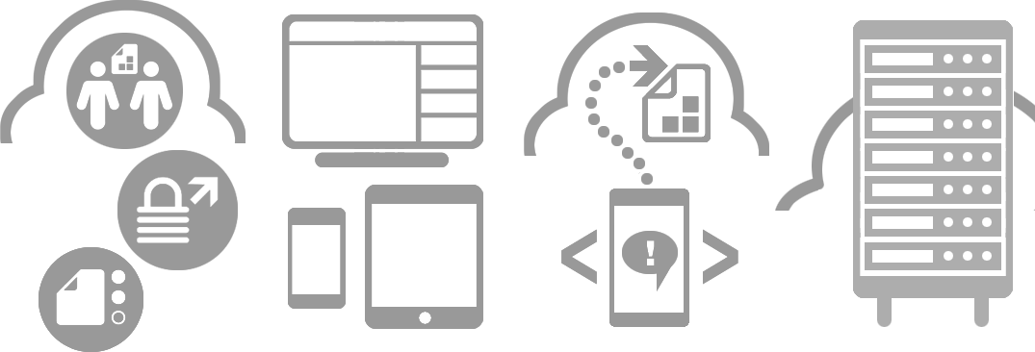








Storage Administrator scenario with Point.io web console
Julien Gaye
Sales Engineer
+44 7708 147 445
jgaye@point.io

Slide 2
Storage Administrator scenario
The Storage Administrator is connecting storage resources to the platform, and allowing Project Manager to use them.
He is managing the Gateways, Storage Sites, the access to Storage Sites by other users and monitors all the activities in his Storage Sites.
In the next slide,
Blue component are available in the current web console
Yellow components exist but are not displayed in the current console

Slide 3
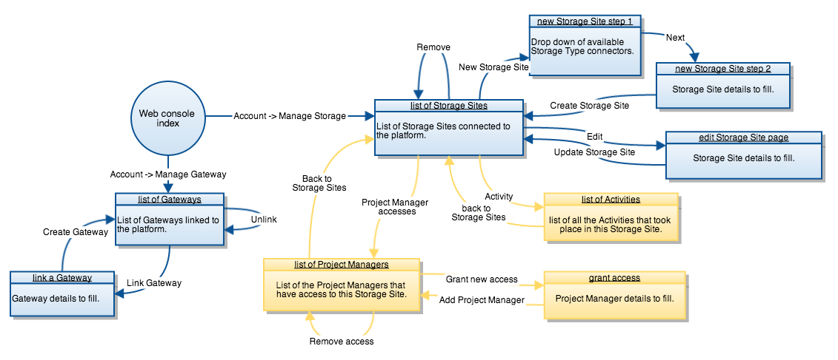
Click a shape to access its description directly.

Slide 4
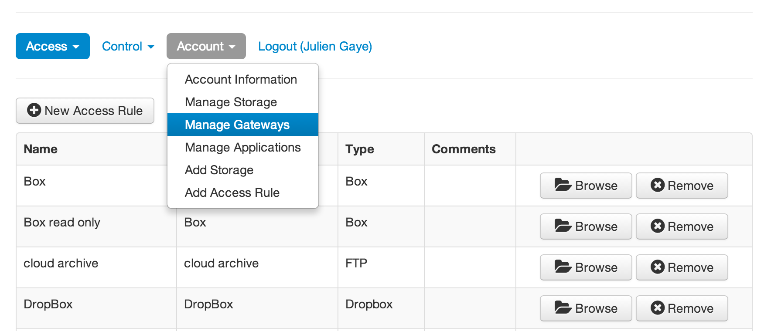
A Gateway is an appliance installed in the enterprise’s network to broker the connections between Storage Sites and the end users.
To access the Gateway management page, the Storage Administrator goes to Account -> Manage Gateways.

Slide 5
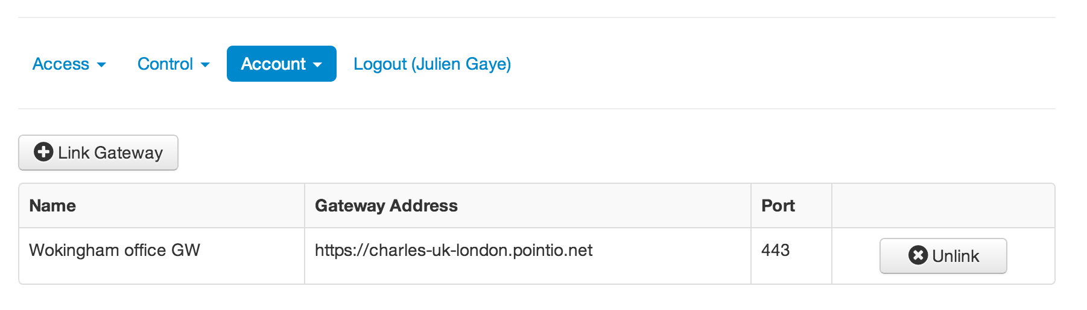
The Gateway management page displays a list of Gateway linked to the enterprise’s platform.
Each entry shows the Gateway’s name, address, and port used to link it.
The Storage Administrator can unlink a Gateway by clicking the “Unlink” button of a specific entry.
A new Gateway can be link by clicking the “Link Gateway” button.

Slide 6
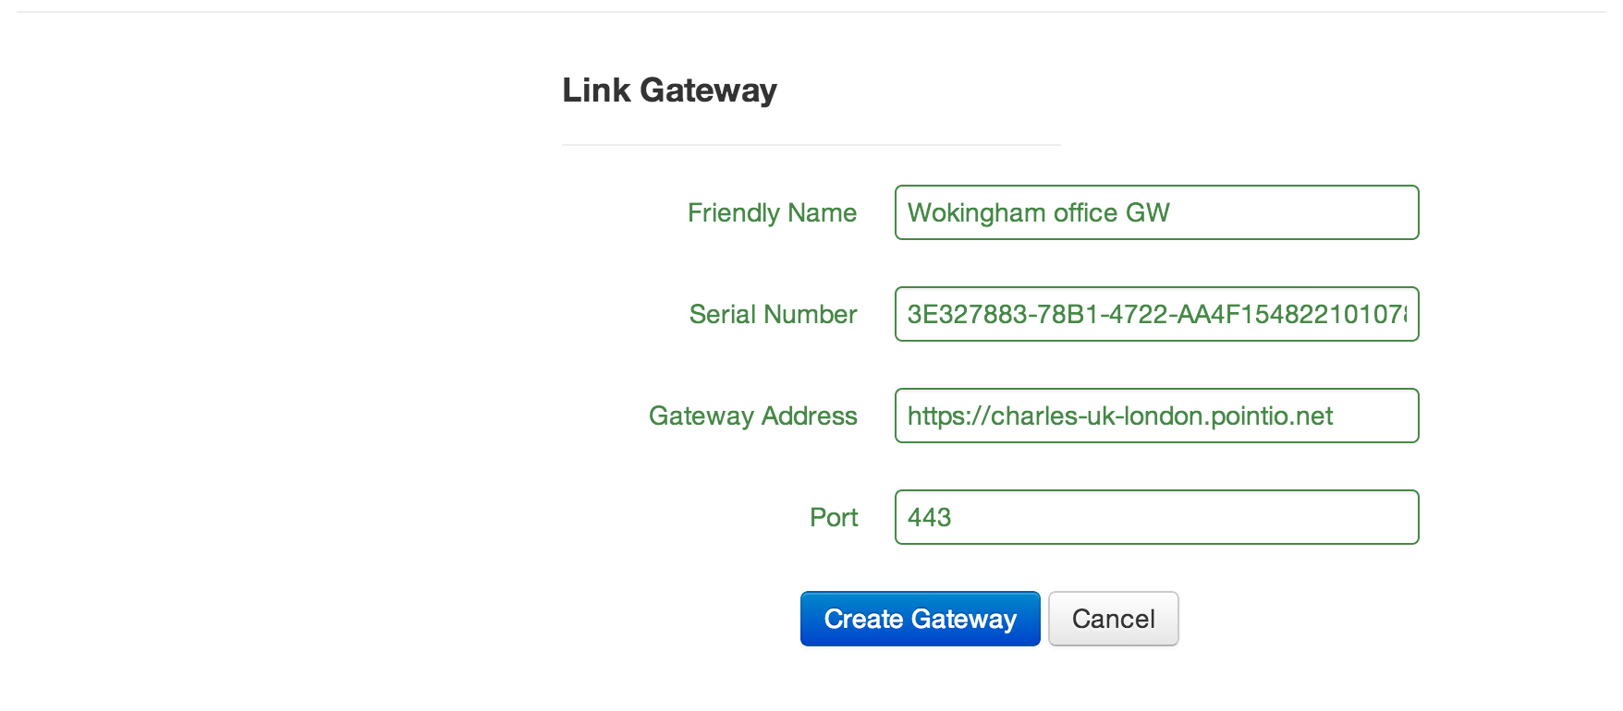
To link a new Gateway, the Storage Administrator must fill the Gateway’s details:
A name that will be used to refer to this particular link in the Gateway list
A serial number
The Gateway address, that can be an IP address or a domain name
The port that redirects to the Gateway
These details depends of the Gateway’s setup inside the enterprise network

Slide 7
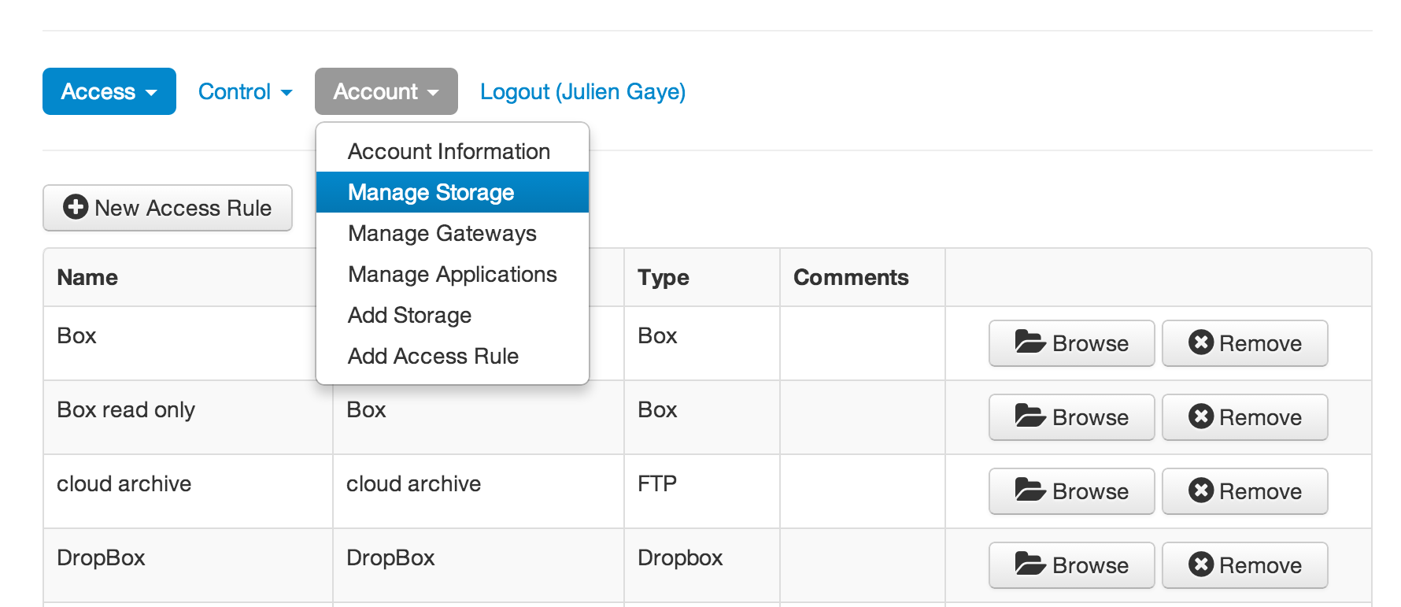
A Storage Site is the representation of an access to a storage location inside the enterprise’s network.
To access the Storage Sites management page, the Storage Administrator goes to Account -> Manage Storage.

Slide 8
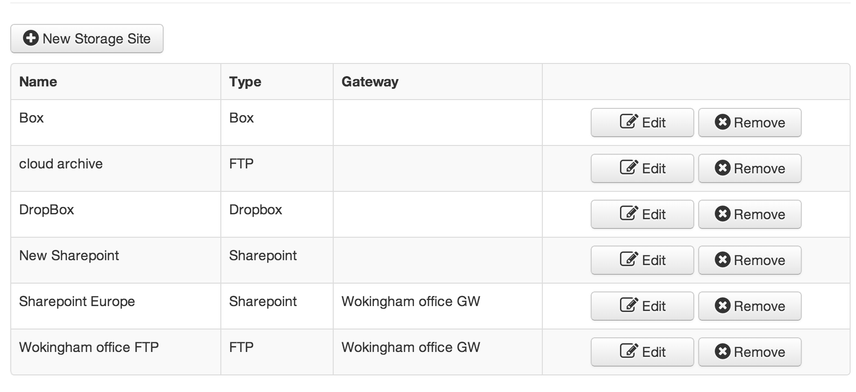
The Storage Sites management page displays the list of Storage Sites created by the Storage Administrator.
Each entry shows a Name, a Storage Type and the Name of the Gateway used for this connection.
The Storage Administrator can remove or edit a specific Storage Site, or create a new one by clicking the “New Storage Site” button.

Slide 9
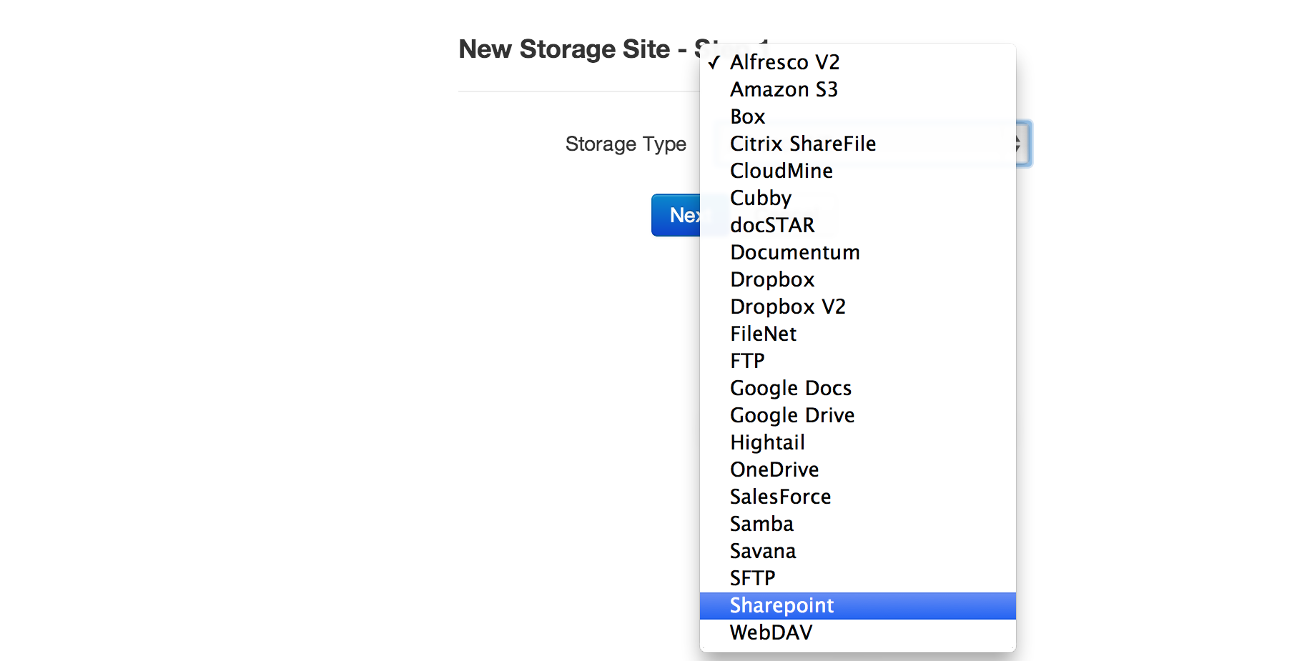
For the Storage Administrator, the first step to create a new Storage Site is to select the Storage Type he/she wants to connect to via the dropdown of available Storage Types.

Slide 10
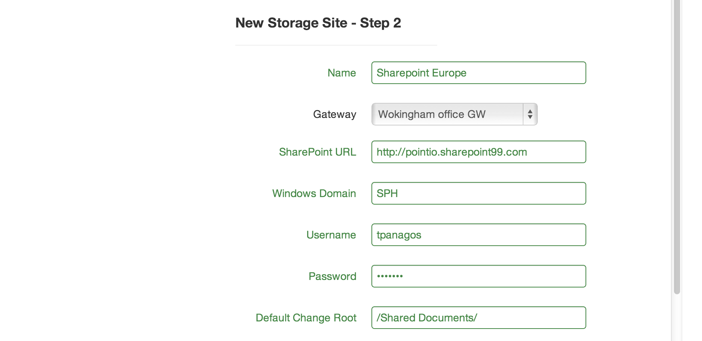
At the second step, the Storage Administrator must fill the Storage Site details:
A Name by which the Storage Site will be referred to in the list
A Gateway that brokers this connection
The Storage Site credentials, that depends on the Storage Type selected
A Default Change Root, that is the folder of this Storage Site that will be see as the root for the Project Managers using it
Tick the “Site enabled” option then click “Create Storage Site”.

Slide 11
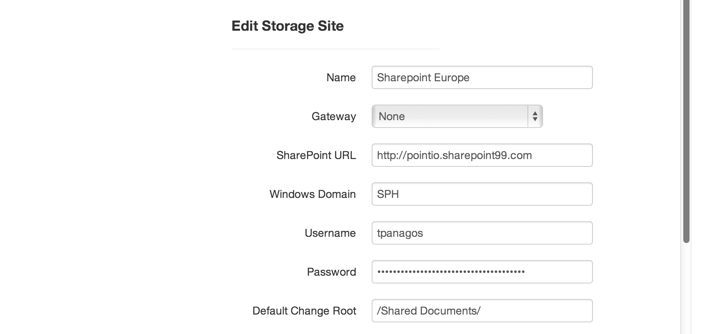
By clicking on the “Edit” button of a Storage Site entry, the Storage Administrator can update this Storage Site’s details.
The fields are the same as for the creation of a Storage Site.

Slide 12
Use case functionalities not implemented in the current web console
The next step would be to grant access to a storage site to a Project Manager, but this is not available with the current console.
The Storage Site monitoring isn’t accessible via the console.

